Slide 1
Introduction to Data Visualization
Tableau
Halil Bisgin, Ph.D.

Slide 2

What is Tableau?
“
is a visual analytics platform transforming the way we use data to solve problems—empowering people and organizations to make the most of their data.”
Visually expresses data by translating drag-and-drop actions into data queries through an intuitive interface.

Slide 3
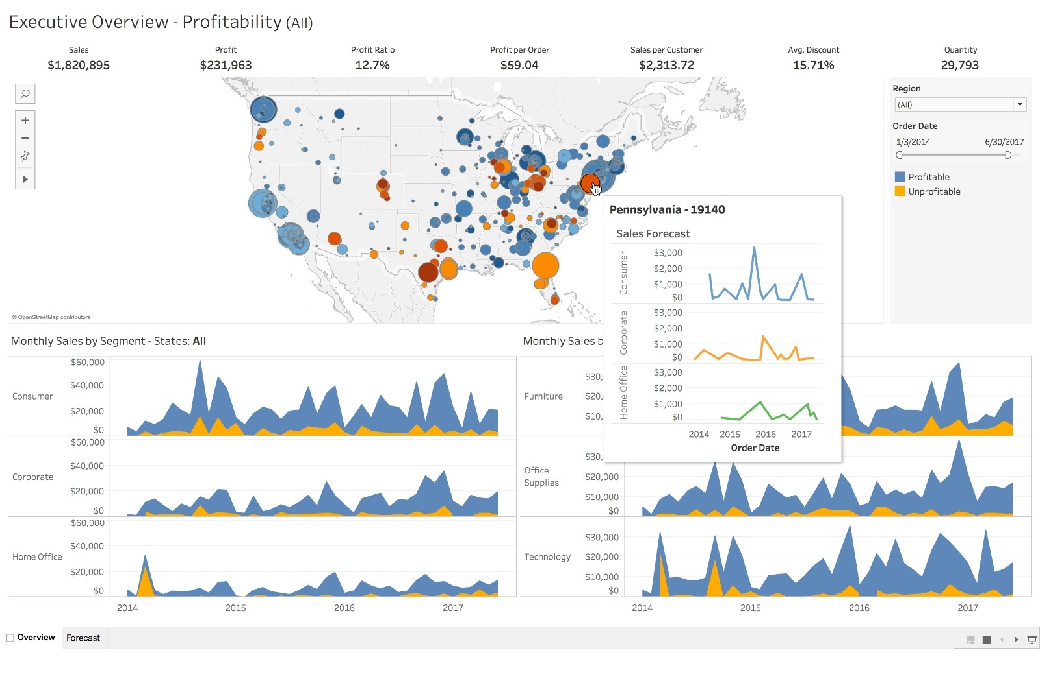
Why Tableau?
No coding: Drag and drop is good enough.
Intuitive: puts more emphasis on asking questions more than learning the software.

Slide 4
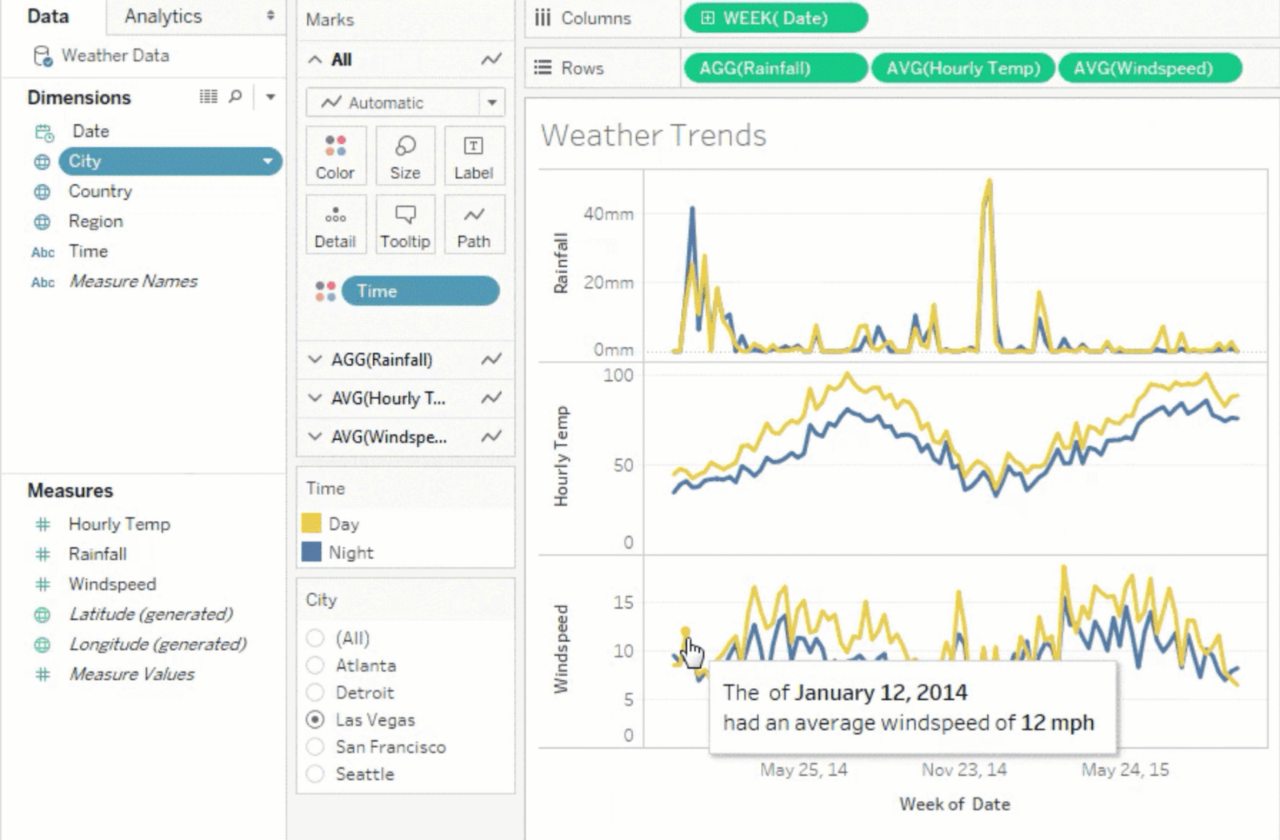
Why Tableau?
Powerful analytics for everyone
Regardless of the skillset, it offers a wider spectrum of analytics environment from data scientists to business users.
Shallow learning curve

Slide 5
How to get Tableau?
Everyone can get the community version.
Tableau Public
Academic/Student version for one year free.
Institutional license.

Slide 6
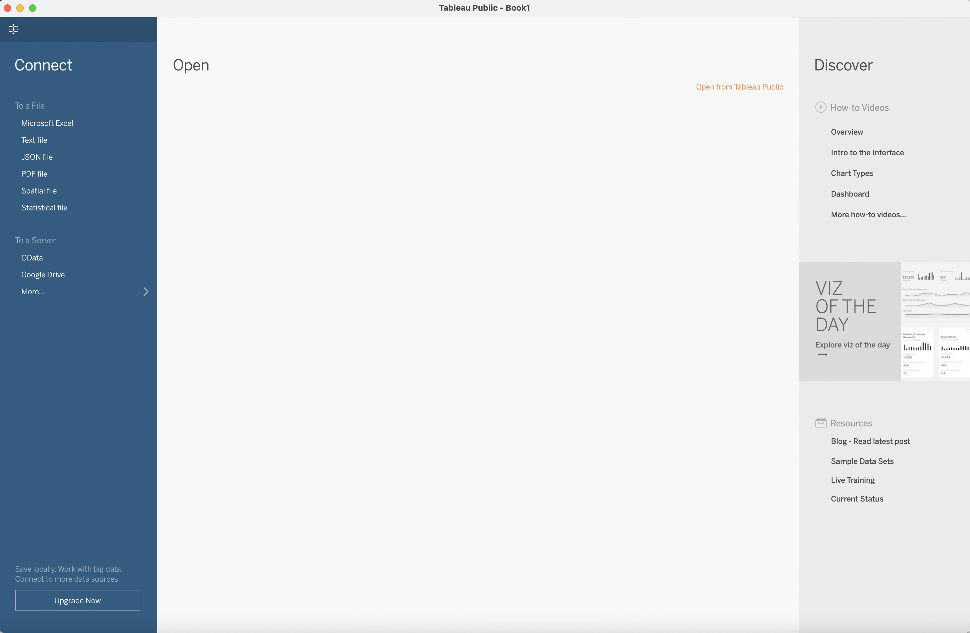
Welcome page
Three panes are for
data import,
inspection/visualization, and
discovering other visualizations done by Tableau

Slide 7
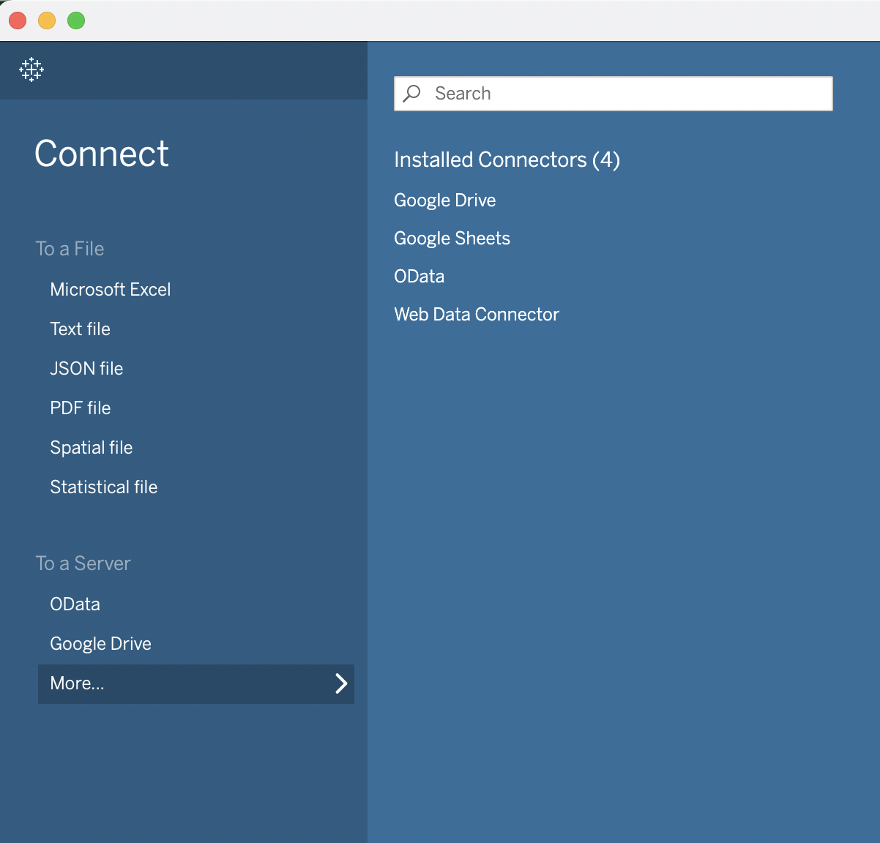
Data import has several options
Google Drive and some others need authorization.

Slide 8
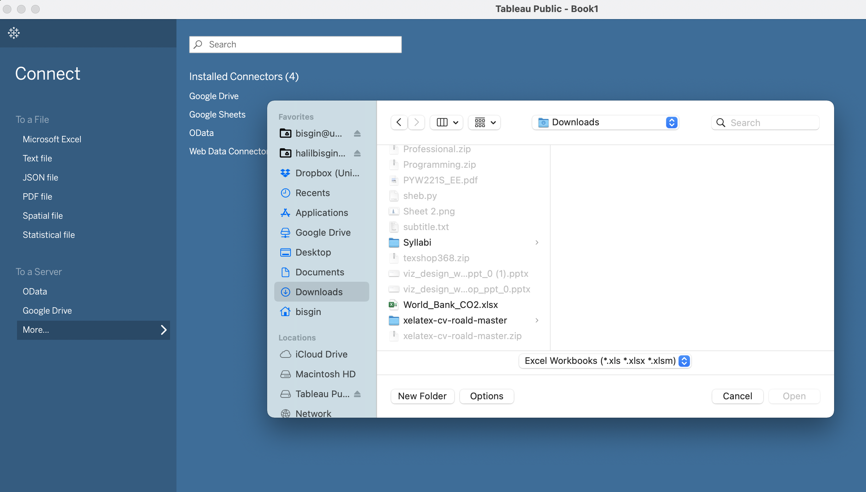

Example-Excel spreadsheet
Just click on the file in the dialog box and open

Slide 9
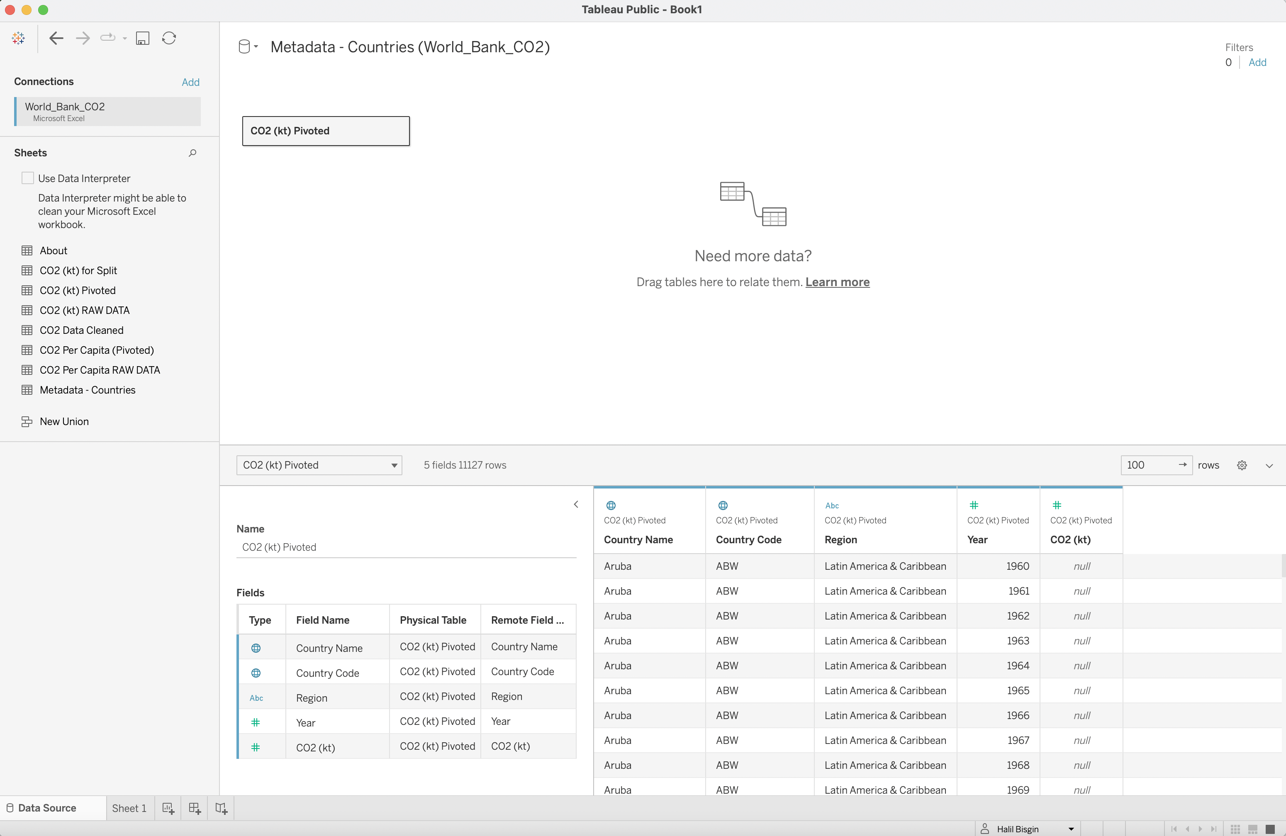
It will show all worksheets in your file
Drag and drop your data sheet here
Click to go to your viz

Slide 10
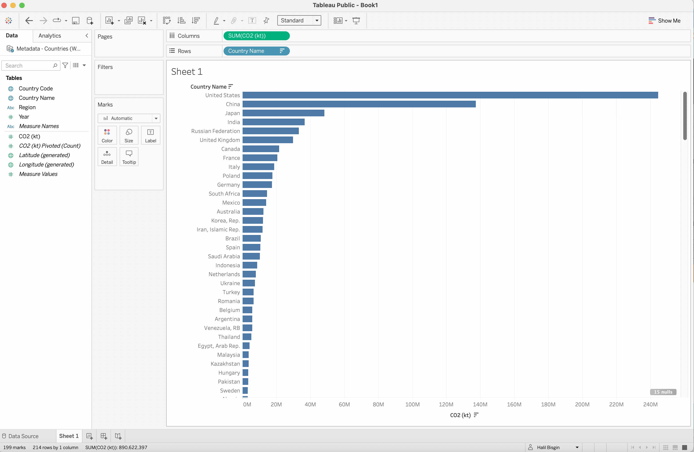
A quick bar plot
We can create a horizontal bar plot and sort values

Slide 11
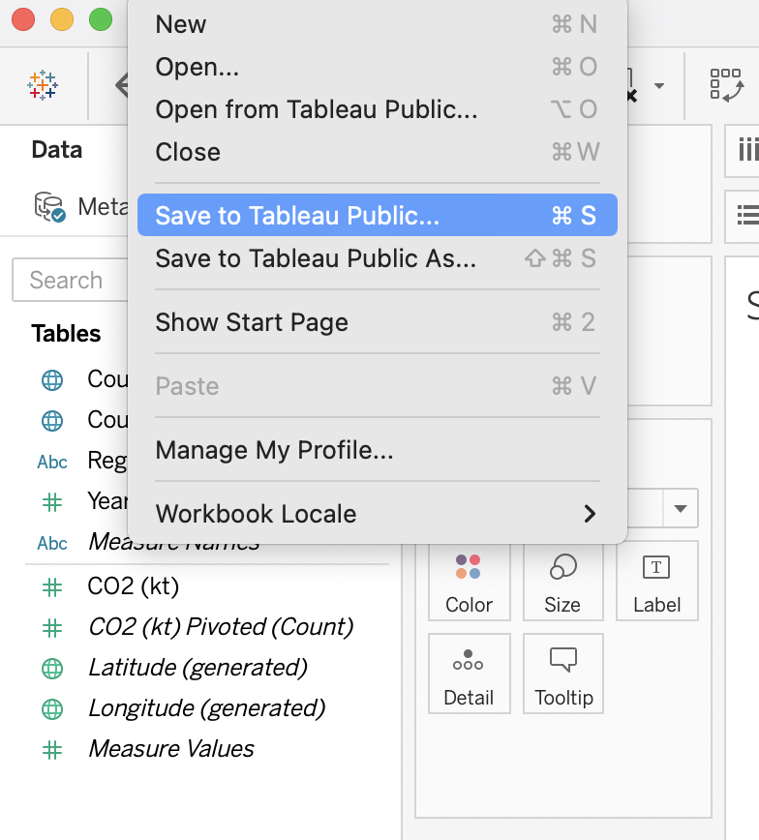
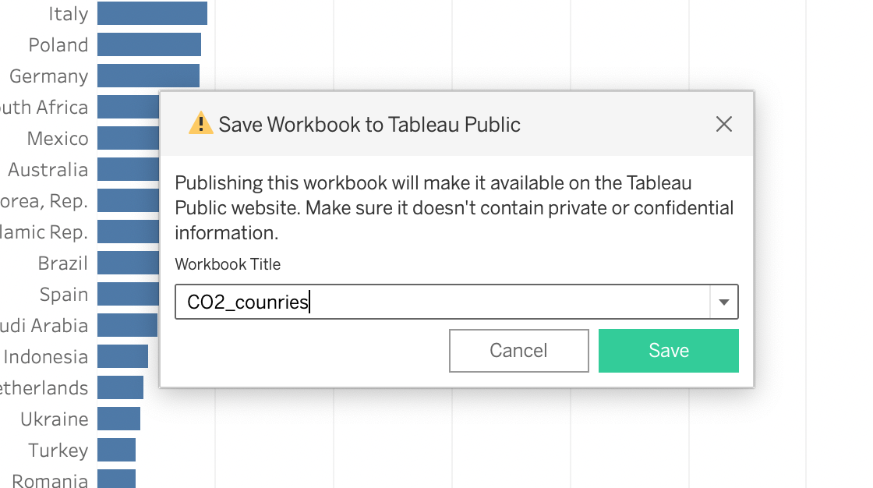
Ready to save & share with the world?
It may ask your Tableau credentials, before saving.

Slide 12
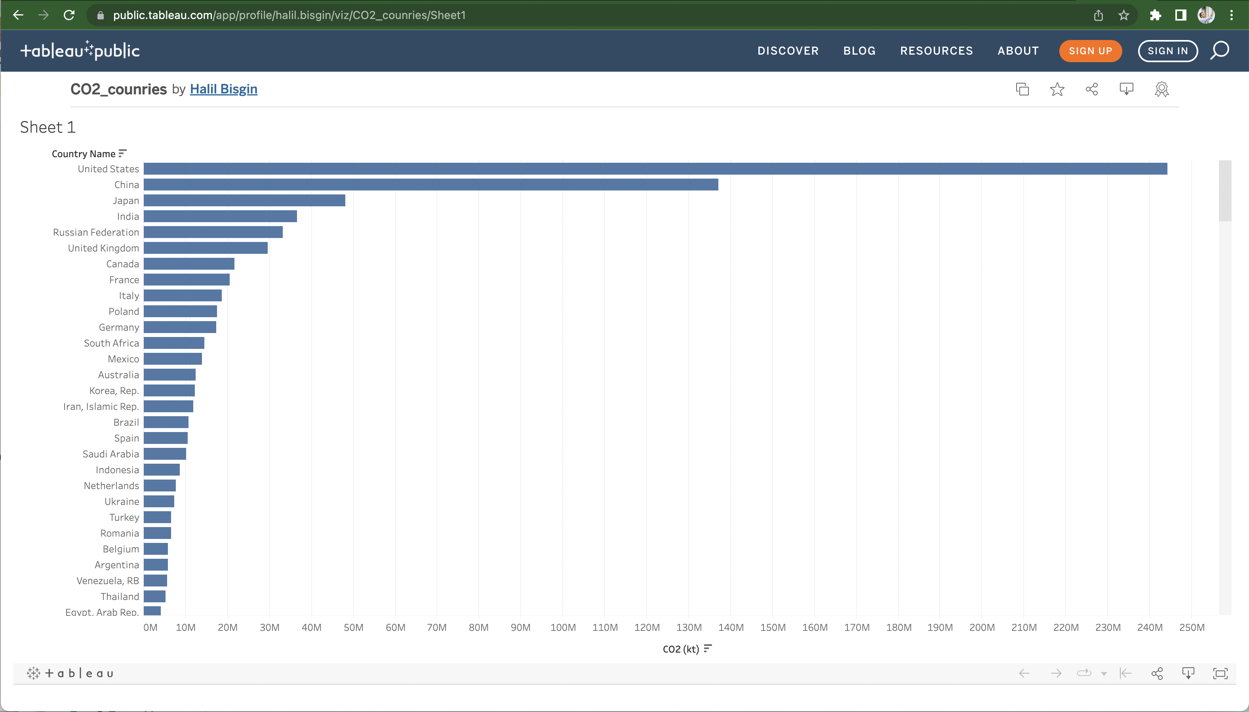
Your work on the net

